Slide 1

Drupal and Windows?!
Juozas „Joe“ Kaziukėnas
http://juokaz.com / @juokaz / juozas@juokaz.com

Slide 2
Before we start

Slide 3

My name is Joe

Slide 4
Who is this guy?
Juozas Kaziukėnas
People prefer to call me Joe
Lives in Edinburgh, UK
Runs Web Species Ltd. (still can write code)
Speaker in PHP conferences all over the world
Open source developer (Zend Framework, Doctrine etc.)
More info http://juokaz.com and @juokaz

Slide 5

* I do not work for Microsoft

Slide 6



http://webspecies.co.uk

Slide 7
Anyone running Drupal on Windows servers?

Slide 8

PHP and Windows

Slide 9

PHP and Windows

Slide 10

Why?

Slide 11

Why?
PHP is the most popular language , 75% of all websites
http://bit.ly/bmCvms
Enterprise/business environments
Windows are very popular there
Clients for PHP shops
Integration with Windows applications and tools
SQL Server etc.
Microsoft’s wish

Slide 12

Migration to Windows

Slide 13
Migration to Windows
And noone asks for it
Changing working systems is stupid and prone to errors
Downtime
Important:
Using in existing Windows systems
Maybe for new projects

Slide 14
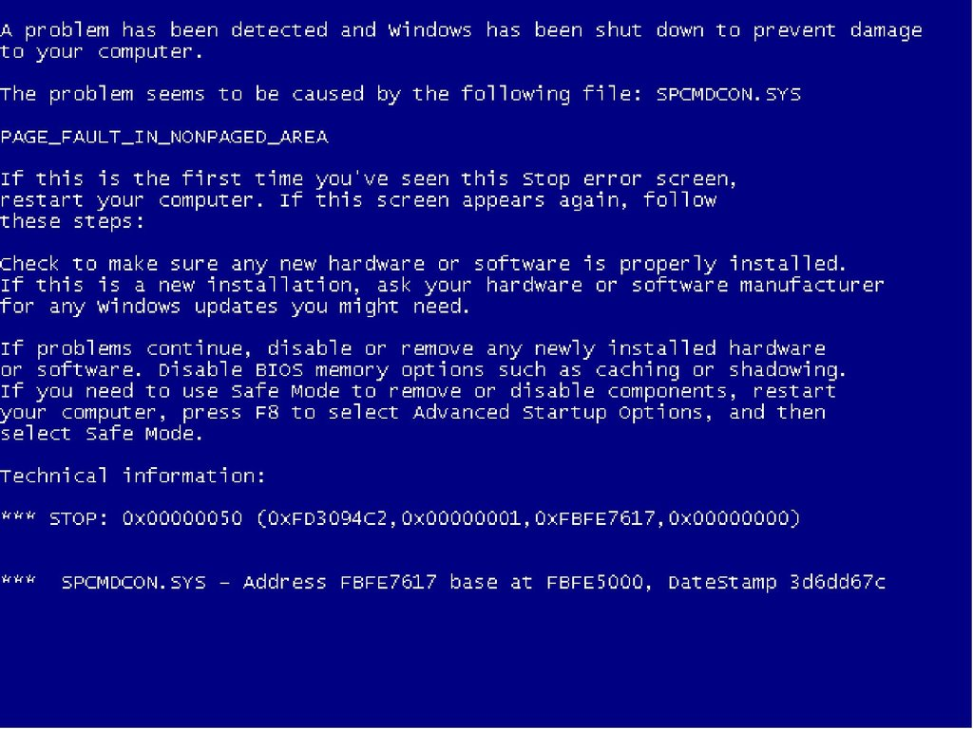

Slide 15
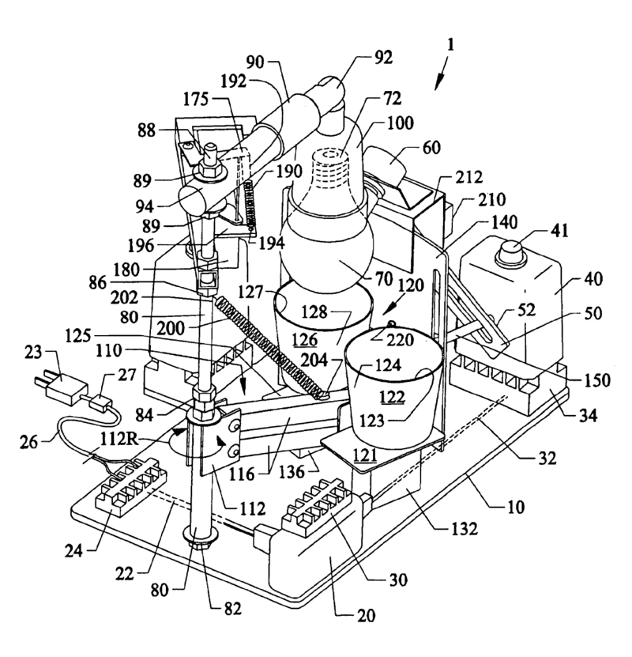
It’s good to know that “it works”

Slide 16

History

Slide 17
History
2006
PHP and Windows = ☹
2007
FastCGI
2008
PHP 5.3 and windows.php.net
2009
PHP 5.3 release
WinCache 1.0
2010
FastCGI 1.5
WinCache 1.1
2011
Drupal 7

Slide 18

Drupal

Slide 19
A lot of Drupal clients want Windows as a server
At least in United Kingdom

Slide 20
Drupal 7

Slide 21
Drupal 7
Support for SQL Server
2005 and 2008
Runs on IIS web server out of the box
Runs on Azure
Media storage backend
Microsoft plugins:
Bing maps
LiveID
Odata
Silverlight pivot viewer

Slide 22

http://microsoft.com/web/drupal

Slide 23

???

Slide 24
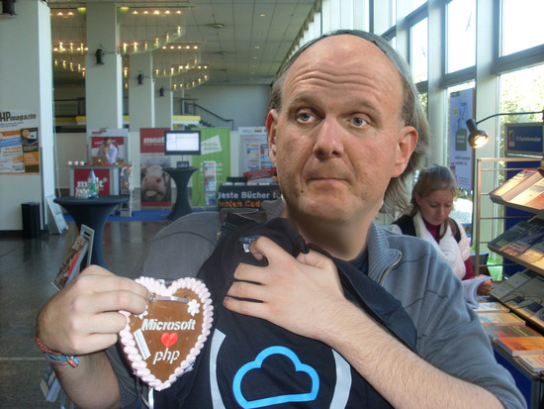
PHP and Microsoft

Slide 25

PHP and Microsoft

Slide 26

Tools and technologies

Slide 27
WebDeploy
Deploy tool
Allows migrating IIS 6 -> IIS 7
Configuration, source code, DB’s, DLL’s etc.
Dependencies
Servers synchronization
No admin permissions are required

Slide 28
Web Platform installer
Using WebDeploy
Web server setup with one click
IIS, PHP, Microsoft SQL Server, .Net etc.
Web App Gallery
Drupal, Wordpress etc.

Slide 29
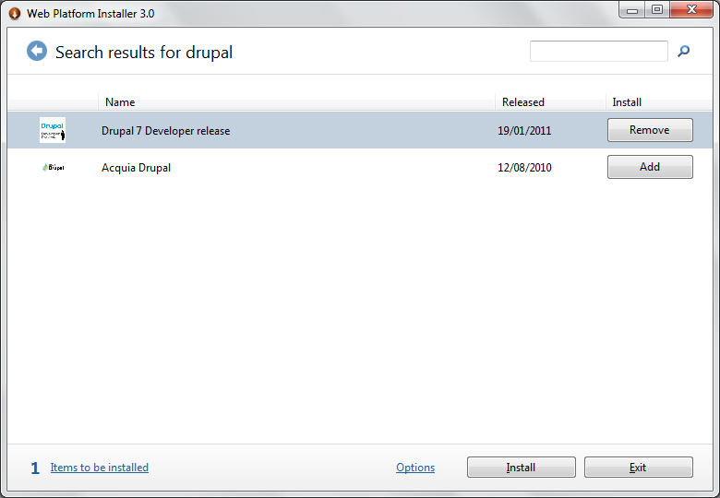
Web App gallery

Slide 30
IIS tools
PHP Manager for IIS
URL Rewrite
Logging
Database manager
Cache warm up
SEO toolkit
Etc.

Slide 31
WinCache
APC replacement for Windows
Same API as APC
Performance gain for free
Somewhat integrated into Drupal

Slide 32

Performance

Slide 33
Performance
Horrendously slow before
Comparable today
IIS tests
http://www.slideshare.net/ruslany/php-performance-on-windows
Apache vs IIS
http://techportal.ibuildings.com/2009/11/19/php-on-windows-the-wincache-1-0-benchmark/

Slide 34
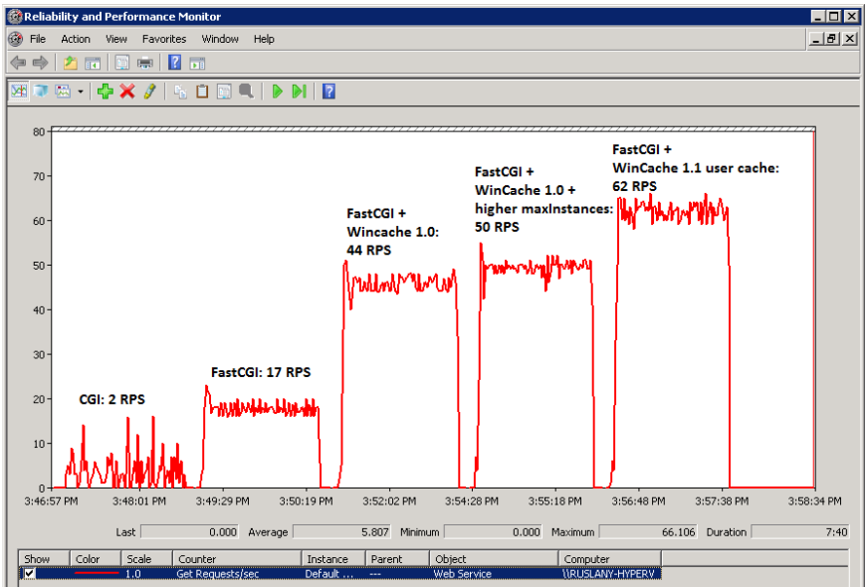
IIS

Slide 35
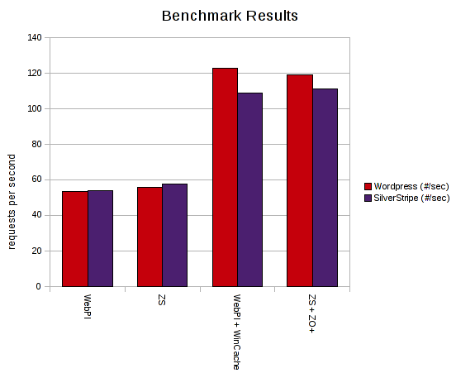
Apache vs IIS

Slide 36

Yes?

Slide 37
Questions?

Slide 38

Thanks!
Slides will be available online soon
Local Microsoft contanct:
Tiago Andrade e Silva - tiagoand@microsoft.com
Contact me on:
http://juokaz.com
juozas@juokaz.com
Twitter: @juokaz

